Slide 1


Taking the Stress Out of
Homebuying
Mercy University
Office of Alumni

Slide 2
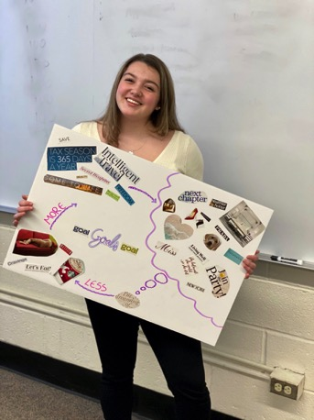
Our Mission
My Money Workshop is a nonprofit organization that educates people to manage their finances wisely and to make a lifetime of informed decisions.
My Money Workshop, Inc. instructors and guest speakers are volunteers. Please note that we provide the following information for educational purposes only during the live webinars, and is not intended to be, and should not be considered, advice with respect to your personal finances.

Slide 3
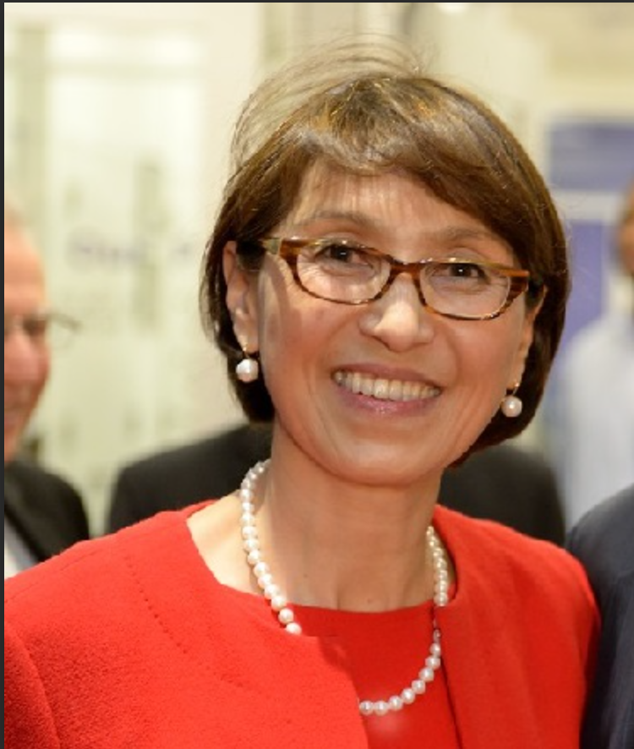
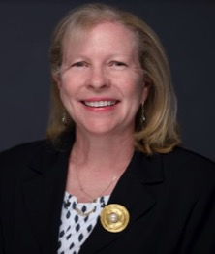
Today’s My Money Workshop Presenters
Mira Ness
CEO - New York University Federal
Credit Union
Veronica Ferrero
VP Community Lending Officer
Senior Mortgage Consultant
Emigrant Mortgage, a Division of Emigrant Bank
Alex Evans
Community Lending Coordinator
Mortgage Consultant
Emigrant Mortgage, a Division of Emigrant Bank

Slide 4

Poll
When do you plan
to buy a home?
Is anyone a
first-time
home buyer?
Comment
in the chat please

Slide 5

Home Buying
How do you even start?

Slide 6

Get Prepared
Follow these steps to get to your first home!

Slide 7

Step #1 …
Take the time to prepare.
Have a smart goal (ex. save $10,000 in one year for a down payment)
Determine what you can afford – have a budget and stick to your budget
Know the real estate language (ex. condo vs. co-op)
Start saving early
  Find ways to save on current expenses for a future down payment. Be prepared with a fund for closing costs, taxes, monthly utility bills, insurance, repairs … an emergency fund for the unexpected is a must have.

Slide 8

Ways To Save
Explore down payment
and mortgage options.
  A home buyer struggling to come up with a down payment can look at Conventional Mortgages. These conform to standards set by government-sponsored entities like Fannie Mae and Freddie Mac and require a reduced % down. Or Federal Housing Administration(FHA) Loans that permit much lower down payments and Veterans Affairs Loans that sometimes require no down payment.
Research state and local assistance programs
  In addition to federal programs many states offer assistance programs for first time home buyers with perks like down payment assistance, closing cost assistance, tax credits and discounted interest rates. County and municipalities may also have first-time home buyer programs
Set aside tax refunds and work bonuses for a future down payment.
Take advantage of direct deposit – your bank can divide incoming funds into at least two accounts. Link a savings account and choose a dollar amount per incoming direct deposit.

Slide 9

Step #2 …
Hire the Right Team!
A Realtor - choose a real estate agent that connects well and understands your needs. Your agent will not only help you find a home of your dreams, but a good agent will act as your go between with the other members of your team and the seller’s agent.
An Attorney – best to choose an attorney that specializes in real estate. Your attorney will review the terms and conditions in your contract of sale before you sign.
A Mortgage Lender - find a mortgage lender you can trust and who is responsive. The right mortgage lender can save a home buyer time and money. Options are a Mortgage Broker, Retail Bank, Credit Union or Mortgage Bank.

Slide 10
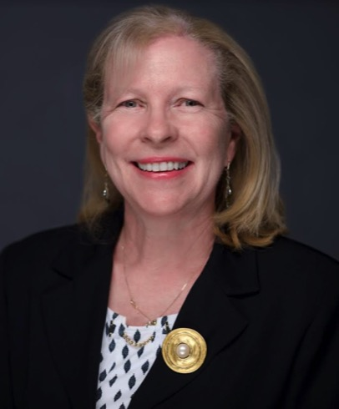

Industry Experts
Emigrant Mortgage, a Division of Emigrant Bank
Veronica Ferrero, AVP Community Lending Coordinator Emigrant Mortgage, a Division of Emigrant Bank
Veronica Ferrero
VP Community Lending Officer
Senior Mortgage Consultant
Alex Evans
Community Lending Coordinator
Mortgage Consultant

Slide 11

Home Buyer Seminar
Mercy University
Office of Alumni
March 5th , 2024 Webinar
PRESENTERS:
VERONICA FERRERO, VICE PRESIDENT / COMMUNITY LENDING OFFICER
EMIGRANT MORTGAGE, A DIVISION OF EMIGRANT BANK
OFFICE: 516.822.6992 / EMAIL: FERREROV@EMIGRANTMORTGAGE.COM
ALEX EVANS, MORTGAGE CONSULTANT / COMMUNITY LENDING COORDINATOR
EMIGRANT MORTGAGE, A DIVISION OF EMIGRANT BANK
OFFICE: 516.822.7564 / EMAIL: EVANSA@EMIGRANT.COM
Information contained within is intended to be used for general information purposes. Emigrant Mortgage, a Division of Emigrant Bank – NMLS#607759 (Emigrant) /// 03/24.
Source: FDIC Money Smart, Module 6: Credit Reports and Scores, PPT slides and Participant’s guide and Zillow.com.

Slide 12
Who’s Who in the Mortgage Process
Real Estate Agent - A real estate agent is a person who acts as an intermediary between sellers and buyers of real estate/ real property and attempts to find sellers who wish to sell and buyers who wish to buy. They can often provide helpful and specific community information such as shopping, transportation, and schools.
Real Estate Broker - A broker is a licensed real estate professional who represents the sellers or buyers of a property, and can typically help determine the market values of properties. While a broker may work independently and has the ability to manage their own firm, an agent usually works under a licensed broker to represent clients.
Mortgage Lender – A financial institution that issues loans. Unlike brokers, lenders control the whole process, from underwriting to funding.
Loan Officer - A Loan Officer represents one lending institution and their loan programs. They help you choose the best mortgage loan based upon your situation and will help you complete the loan application.
Loan Processor – A Loan Processor is one who gathers, administers, and processes your loan application before it gets the approval of a loan underwriter. This individual is essential to getting your mortgage loan request to the final close.
Property Inspector - An individual certified to conduct an examination of the home. An inspector will look for issues that may affect the value of the property and can assess the condition of a property's roof, foundation, heating and cooling systems, plumbing, electrical work, water and sewage, and some safety issues.
Source: ENACT Mortgage Insurance Corporation

Slide 13
Who’s Who in the Mortgage Process (Continued)
An Underwriter - A worker who evaluates and determines the risk for potential clients when applying for a mortgage. They may decide whether and under what terms to provide the mortgage.
Mortgage Insurer – By compensating the lender for losses should a borrower be unable to make payments, Mortgage Insurance allows a borrower to get into a home without having to come up with a 20% down payment. Many Mortgage Insurers, such as Enact Mortgage Insurance, can assist borrowers if they become behind in their mortgage payments.
Appraiser - An individual who is licensed to estimate the worth (fair market value) of the property you are purchasing.
Closing or Settlement Agent - The party who conducts the closing meeting. This role may be filled by an attorney, title company, or real estate agent depending upon the state where the property is located.
Loan Servicer – A The entity that collects mortgage payments (it may or may not be the lender) and pays taxes and insurance and mortgage insurance, if required, on your behalf.
Source: ENACT Mortgage Insurance Corporation

Slide 14

Section 1
Steps to Purchasing a Home

Slide 15
5 Steps to Prepare for House Hunting
Before you attend your first open house, take some time to imagine your ideal home:
1 | 2 | 3 | 4 | 5
Research Your Ideal Location | Calculate Your Price Range | Determine a Size and Layout | Identify your Non-Negotiable | Consider Resale Value
Education & Healthcare Safety Commute & Public Transportation Quality of Life | Average Rents Home Prices Property Taxes Overall Cost of Living in a Location where you intend to Live | Consider how long you plan to live there and how your needs might change over the years. Whether you might need an extra bedroom or two down the road and how much space you can afford | A home buying wish list can help identify and prioritize what you need versus what you want in a future home. Location, Size, Property Condition, Amenities ... you can easily check in person and online | Things that can impact the resale value of a home: Amenities: Garage, Pool, Yard … Specialized Style: Nontraditional homes don’t appeal to everyone Outdated: It may take longer if the house needs work
Source: https://myhome.freddiemac.com/blog/homeownership/5-steps-prepare-house-hunting

Slide 16

10 Steps to Purchasing A Home
Check your credit report and score
Figure out how much you can afford
Find a Real Estate Agent
Get pre‐approved by a lender
Start looking at homes
Make an offer
Home inspection day
Get insurance and establish utilities
Closing day
Get the keys and move in!
Source: Zillow.com

Slide 17
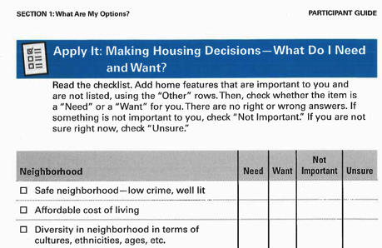
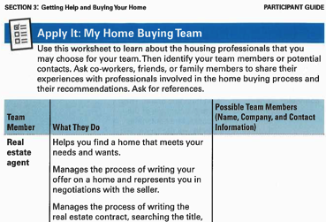
Making Housing Decisions and Buying A Home Worksheets
Utilizing Worksheets and mapping your path to homeownership is the best way to successfully get to where you want to go.
Please do not hesitate to contact me should you wish to have these documents sent to you and begin the journey.
MONEY SMART FOR ADULTS Module 12 and 13 Participant Guides

Slide 18
4 C’s of Credit
Capacity
Income, employment history, savings & monthly payments on debts such as credit card charges and other financial obligations.
Do you have the ability to maintain payments on the loan?
Capital
Available money and savings plus investments; also property & other assets you can sell quickly for cash.
Do you have enough funds to close the deal & maintain a reserve?
Collateral
The value of the property purchased, that will be pledged as security for the loan.
What is the condition & market value?
Credit
Lenders check credit score and payment history to assess if bills & other debts have been paid on time and in full.
Have you maintained or re-built strong credit?
Sources: https://myhome.freddiemac.com/blog/homeownership/20171204-4Cs-qualifying-mortgage and MoneySmart for Adults Module 7: Borrowing Basics September 2018

Slide 19
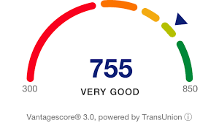
Section 2
Credit Report Training
Your credit history can affect your access to credit, loans, jobs, housing, insurance and other important services

Slide 20



What is Listed in a Credit Report?
Your identifying information
Your debts and some bills
Public record information
Your applications for new credit and other “inquiries”
The nationwide credit reporting agencies are:

Slide 21
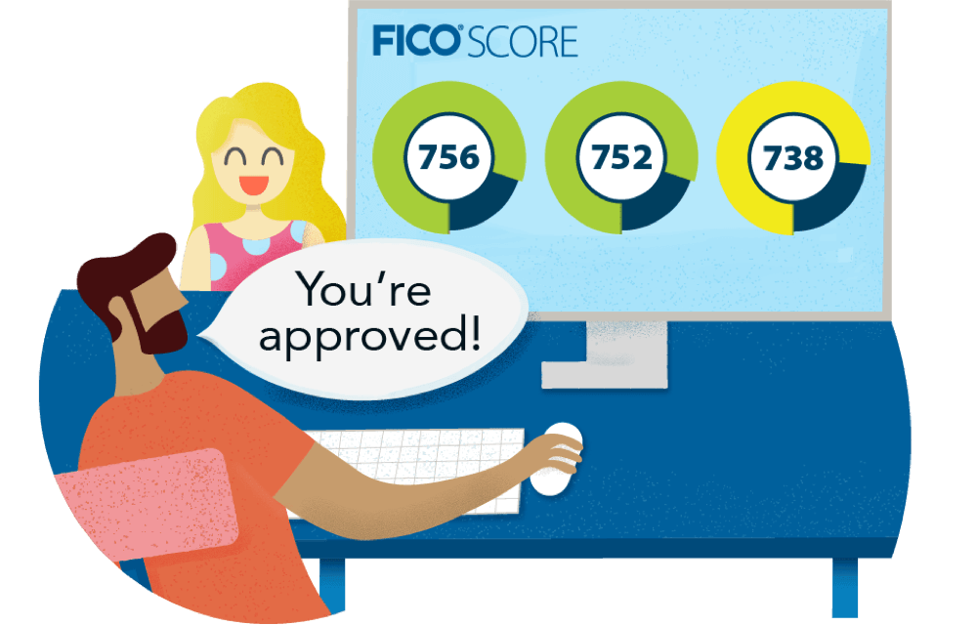
Who Uses Credit Reports and Scores?
Financial institutions
Some landlords
Utility companies
Some cell phone companies
Insurance companies (in some states)
Employers (in some states)
Some state agencies or affiliated organizations

Slide 22
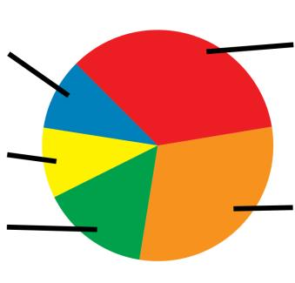
Five Factors in General FICO® Model
Payment History – 35%
New Credit – 10%
Credit Mix – 10%
Length of
Credit History – 15%
Amounts Owed – 30%
Credit Scores & Mortgages
In terms of Credit Scores and Mortgage Loan Pricing the following applies:
740 and above is Ideal
700 – 739 is Average
699 and below – will significantly increase pricing.

Slide 23
Apply it: Getting My Credit Reports
You can order the free credit reports you are entitled to by law from the three nationwide credit reporting agencies either online, by mail, or by phone.
There are also “specialty” consumer reporting agencies that track, for example, a person’s history of handling a checking account. For information, visit consumerfinance.gov and search for “list of consumer reporting companies.”
Online | Mailing
1. Go to annualcreditreport.com. This is the only place authorized to fill orders for the free credit reports you are entitled to every 12 months under the law. | 1. Complete the Annual Credit Report Request Form located at www.annualcreditreport.com/ manualRequestForm.action.
2. Complete the online form with your name, date of birth, Social Security number, current address, and previous address if you have lived at your current address for less than two years. | 2. Mail it to: Annual Credit Report Request Service P.O. Box 105281 Atlanta, GA 30348-5281
3. Pick the report(s) you want: Equifax, Experian, or TransUnion. For each of the three reports, you will complete an additional form that includes security questions based on information from your credit report. If you are unable to answer the questions, you will need to use another method to get your reports. Make sure you are on a secure Internet connection—try not to use a public wireless Internet connection or a public computer. Make sure you can either print your report or save it. However, if you are using a public computer, do not save the report. Instead, print it and take the report home. | Phone Call 1-877-322-8228

Slide 24

Build, Repair, and Maintain a Productive Credit History
Dispute and correct any errors
Make sure collection accounts on your report belong to you
Pay all bills on time as agreed
Try and use no more than 20 or 30% of your available credit
Keep old accounts open. Older accounts create a longer credit history
Too many inquiries can negatively affect your scores
Don’t apply for too much or new credit
Pay your taxes & child support in full and on time

Slide 25
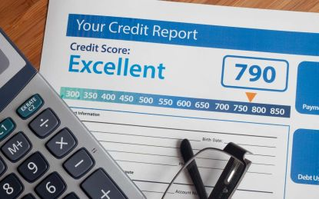
Build Alternative Credit History
Document other payments you regularly make, such as:
Rent
Childcare
Cell phone bill
Electric bill
Gas bill
Water, sewage, and garbage bills
Television service bill
Internet service bill
Insurance payments
Loan from friend or family member
Savings

Slide 26


Build Credit Maintain Credit
Get a secured credit card
Become an authorized user on an account
Get a cosigner
Apply for a credit card at a store or gas station
Pay your bills on time and as agreed
Continue to pay down your debt balances
Keep the proportion of the credit you use low compared with credit limits
Keep good financial records and don’t apply for too much credit
Pay your taxes and child support in full and on time

Slide 27

Section 3
Common Home Buyer Questions
Now you have learned about the basics of credit management…. Next up common Questions related to
the First Time Home Buying Process

Slide 28

Questions:
What is the most important thing first time buyers need to know?
How and where should a first-time buyer look for their first home?
Can you give us a quick overview of financing options? What about low and no down payment options?
How do you come up with a down payment?
What are Grants and how can they benefit a borrower?
Where are mortgage rates now?

Slide 29

Before We Go …
Home Buyer Mistakes to avoid
Not budgeting enough for closing costs
  In addition to saving for a down payment, a home buyer needs to budget for the money required to close the mortgage. This can be a significant amount. Do your research and be prepared.
Not saving enough for move-in expenses
  Once you have saved for your down payment and budgeted for the closing costs, you should have a plan to cover moving expenses, any necessary home improvements – new paint, carpeting, appliances, etc.
Not buying adequate homeowners insurance
  Before a home buyer closes on a home, the Mortgage Lender requires the buyer to purchase homeowners insurance. Shop around and compare rates to find best price. Look closely at what is and not covered in the policies. Going with a cheaper policy means fewer protections and more out of pocket expenses when a homeowner files a claim. Be aware of exclusions. Example - if you live in a flood prone area, you need to buy supplemental insurance in order to be protected.

Slide 30

Key Take-aways
Be informed!
Research and Compare Your Options!
Get started early
Get a loan pre-approval letter
  This will show any seller that you have taken the necessary steps financially to qualify for a mortgage. Plus, confirms what you can afford.
Know what is in your credit report
  Home buyers must know their credit score and have everything in order before beginning the process of purchasing a home.

Slide 31

Let’s continue the conversation

Slide 32
Additional Questions to Ponder
Are there any down payment assistant programs in Westchester County
Credit score and down payment needed to purchase home
How many lenders do you recommend getting a pre-approval from?
How much do I have to put down
How much money should be saved up for a home? Are there any programs that give financial assistance for first time home buyers?
I have a lot of school debt and credit score is not the best. Is it still possible to apply and get approved?
Is it good to consolidate debt to pay down credit cards and improve your score to get better loan options
What is a good FICO Score to have to purchase a home

Slide 33









Follow us
@mymoneyworkshop
This Photo by Unknown Author is licensed under CC BY-NC
Notes:
Activity: If you have your phone near you, please take it out and follow My Money Workshop of IG and FB where you can get more financial literacy data and information.

